Slide 1
The FOMO Fund: How the Fear of Missing Out Affects Retirement Contributions
Josephine McKelvy, PhD
July 8, 2025

Slide 2
Agenda
What might help? Peer Influence
Study design
Takeaways
Limitations
Why increase employee contributions?

Slide 3
Why might large employers want employees to contribute to retirement?
Recruitment
Retention
Growth
Notes:
Feedback loop of recruit, retain, grow with stats from PWC, Bank of America
Recruit top talent as an employer to choice that values employee wellbeing
According to the Society for Human Resources Management, 76% of employees consider retirement plans an important factor in their job decisions. (Slavic401k.com)
Retain top talent
Stat for satisfaction, engagement, loyalty, productivity
Boost employees’ retirement readiness
In a recent Pricewaterhouse Cooper survey, 49% of employees surveyed said that money worries had a severe or major impact on their mental health in the last year. This can directly affect their engagement in the workplace, productivity levels, and even retention. In fact, employees who are stressed about their finances are twice as likely to look for employment elsewhere.
Reduce tax liability for tax-deductible employer contributions
Tax savings
Creditworthiness: According to a report by the National Small Business Association…financial institutions view businesses with robust retirement plans as more stable (slavic401k.com)
too little employee savings can cause your plan to fail IRS discrimination tests (for us all)
These tests help ensure that the highly compensated employees (HCEs do not disproportionately receive more benefits than lower paid rank-and-file employees (non-HCEs). (ascensus)
Email (study) can help

Slide 4
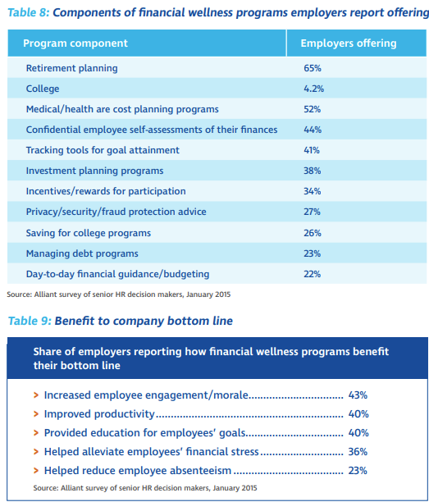
National Fund for Workplace Solutions

Slide 5

Study Design: Could emails inspire federal workers to increase retirement contributions?
Aug 2018
Sep 2018
Dec 2018
Email reminders to enrollees
Jan 2017 to Jul 2018
Automatic enrollment into TSP
Review TSP contributions
No email
Personalized email
Peer email
Notes:
N=1,254 federal (civilian) employees
Tenure: less than 2 years
Automatically enrolled (Jan 2017-July 2018), no changes to default contribution amount
Age: 19-80 (median 36 years)
No outstanding TSP loans, unknown seniority/salary
Email on file

Slide 6
Takeaways: Workers were learning from peers’ mistakes and started contributing more.

Slide 7
Limitations: Which makes one wonder…
Controls & design
Awareness versus peer influence
Ability contribute & propensity to save
Age
Socioeconomic class
Gender
Notes:
Design
The author noted that the variations in email design, subject line, and senders (i.e., workers’ trust in the sender) could have impacted the different effects of the personalized versus peer influence email messages. Future studies ought to compare identical products that only vary in messaging to test the concept of interest—that is, the part that draws users’ attention to personalization and/or peer influence—to rule out other explanations for what happened.
Any email at all could have also primed workers to change their contributions. Future studies could compare the peer influence messaging to a generic “open enrollment”-style email as the baseline (as opposed to no email) to test the effect of peer influence (as opposed to the effect of receiving an email).
What else might help/hinder workers from contributing?
The author noted that the bar can sway the comparison. Did the emerging peer influence come from:
Younger workers, with less seniority and lower wages, potentially feeling discouraged when comparing themselves to more settled staff?
Birds of a feather, trying to “keep up with the Jones” in figuring out the new normal for retirement contributions?
Seasoned staff, feeling empowered by learning from the mistakes of their more naïve colleagues?
It was unclear which persona was at play when the age distribution of workers ranged from 19 to 80 years old, even with a median of 36. Future studies could tease out such processes with segmented samples of similar workers or test, overall, how age impacts retirement contributions for more targeted outreach campaigns.
The author used the absence of outstanding TSP loans to measure workers’ “amenability to contribute more”. Other factors—such as income, expenses, proximity to retirement, propensity to save or plan for the future—could also impact workers’ capacity and motivations to divert part of their paychecks to retirement. Future studies could investigate class differences in retirement contributions to identify additional financial wellbeing programs to support increased retirement contributions.
There are also gendered differences in financial literacy and motivations.

Slide 8
OTHER OPTIONS
A safe harbor plan is a way to avoid 401(k) discrimination testing and allow for all employees to contribute the maximum allowed by the IRS, regardless of their pay level. Employees are more likely to participate in these plans because they have mandatory employer contributions and immediate vesting. (beacon pointe)
How to choose? Merial women vs men reduce cognitive load (for us all) (what would make women, younger workers want to learn?)
pro-savings tools, such as automatic enrollment (Pew) the automatic deferral savings rate you choose will be the anchor point – a cognitive bias that is hard to overcome. People tend to rely on the first data point when making a decision, and if your plan has the initial contribution level set too low, they are likely to use that low amount as their reference point. (for us all) (Duncangrp.com)
“auto-escalation.” This feature automatically increases the amount an employee annually diverts to his retirement plan. For example, your company’s auto-enrollment feature may divert 6% of a new, young employee’s salary toward retirement. If she selected auto-escalation at 1%, she would save 7% of her salary the next year, and 8% the next. And if her salary is increasing, she may not even notice a difference in take-home pay. (for us all) like billpay—stat about auto pay?
(limitations: administrative requirements, setup costs; Pew)

Slide 9
Thank you
Josephine McKelvy, PhD
(337) 412-3657
josephine.mckelvy@gmail.com

Slide 10
References
https://slavic401k.com/resources/the-benefits-of-offering-an-employer-match-with-a-401k-retirement-plan/#:~:text=Employee%20Engagement%20and%20Morale,productivity%20and%20reduced%20turnover%20rates.
https://www.adp.com/spark/articles/2025/06/the-talent-advantage-how-retirement-plans-can-boost-recruiting-and-retention.aspx
https://thelink.ascensus.com/articles/2019/8/14/why-business-owners-should-try-to-boost-participation-in-their-retirement-plans
https://beaconpointe.com/how-to-increase-employee-participation-in-your-retirement-plan/
https://www.pew.org/en/research-and-analysis/issue-briefs/2017/06/employer-barriers-to-and-motivations-for-offering-retirement-benefits

